Slide 1
DESIGN AND SIMULATION OF A BANKING NETWORK SYSTEM
Submitted to: Dr. P.MADHAVAN
Submitted by: BHAVISHRADHAN E P (RA2011003010596)
ASHWINKUMAR(RA2011003010585)
CHANDRASEKHAR(RA2011003010591)
SYED ABSAR(RA2011003010586)

Slide 2
Problem Statement:-
The Objective is to design and simulate a banking network system which is secure.
Banking network system is a need in modern era because it will-:
Save time and cost because of day to day transmission.
Connect all branches to head branch in same network.
Establish relationship between one branch to another.
Save time and cost because of day to day transmission.

Slide 3
Network Scope:-
This proposed network is designed for a requires 6 main departments for their new outlet which are:
Internal IT support
ATM services
Consumer Banking
Investment Banking
Loans
Insurance

Slide 4
Objective :-
Below are the main goals of the network being to achieve several operational objectives which are:
Every department network is separated. All staffs can communicate through emails and an internal chatting system using port 465.
There should be a guest Wi-Fi is provided to customers. This is an isolated network isolated with only web browsing capabilities.

Slide 5
The IT department consists of a small team that the staffs are mainly performing operational tasks instead of planning and implementations. Your team is required to provide detail documentations so that the IT staffs can troubleshoot their systems with references.
Your team are working to strike a balance between network performance, security and cost effectiveness so that your team can close this deal.

Slide 6
Approach:-
In this project “Design and Simulation of a Banking System” we will discuss the total banking network structure & some security feathers. We did a survey in the different banks and collected some data or information. The OSI layer was introduced by the International Organization for Standardization (ISO) in 1984 in order to provide a reference model to make sure products of different vendors would interoperate in networks. OSI is short for Open Systems Interconnection. Data transmitted between software programs passes all 7 layers. The Application, Presentation and Session layers are also known as the Upper Layers. The Data Link and Physical layers are often implemented together to define LAN and WAN specifications.

Slide 7
REQUIREMENTS

Slide 8
Hardware Requirement:
IBM compatible , Intel Pentium 4,Intel core-i3 based PC with a monitor ,keyboard and mouse, system must have 1 GB Ram, Hard disk 80 GB or of available memo.
Software Requirement:
Packet Tracer
Switch
Router
Server
PACKET TRACER:
LAN, MAN, VLAN, ACL, VPN, & Banking Network Combine diagram, Protocol, and different branch transmission simulation.

Slide 9
Network Design Composition:-
1.There are SIX (6)departments to be allocated in the branch:
a.Internal IT support
i.Remote access (SSH) to all the networking devices for troubleshooting, except ATM network
ii.The Headquarter had assigned only level 1 support to this branch. Any higher level support such as issues on Wide Area Network (WAN) and Internet Service Provider (ISP) level requiresescalation to a higher level support.
iii.Support level 2 and above will perform remote into the branch through VPN for troubleshooting.iv.Monitor CCTV loads and storage

Slide 10
b.ATMservices
i.Isolated network and directly connect to Headquarter network through 5556 port.
ii.All staffs including IT support has no access to the ATM network.
c.Consumer Banking
i.Uses most of the network traffic load
ii.Handle individual customer related banking matters
iii.Isolated network within this department only
d.Investment Banking
i.Requires Internet access (HTTP and HTTPS only) to support overseas customers

Slide 11
e.Loans
i.Requires Internet access with port 9999 to check customer credit scores
f.Insurance
i.Do not require Internet access but requires port 7772 to connect to national insurance portal
2.Every department network is separated. All staffs can communicate throught emails and an internal chatting system using port 465.
3.Guest Wi-Fi is provided to customers. This is an isolated networkisolated with only web browsing capabilities.
4.AHB Bank has a budget of RM1,500,000. Aslan has requested a detail cost listing in the proposal.
5.The IT department consists of a small team that the staffs are mainly performing operational tasks instead of planning and implementations. Your team is required to provide detail documentations so that the IT staffs cantroubleshoot their systems with references.
6.Your team are working to strike a balance between network performance, security and cost effectiveness so that your team can close this deal.
7.You should state any assumptions to reduce ambiguous information in your proposal.Your team is required to collect more user specifications to ensure a smoother implementation. Aslanis expecting your team to present a full running simulation and proposal in the next meeting.

Slide 12
Security Requirements:-
Here are the main objectives of our network’s security requirements which comprises of:
Users are required to change their password every 90 days.
The IT Department are given the privilege to access all the group’s network and they are able to conduct troubleshooting activities remotely to all the groups’ network.
Firewalls will be implemented within the server to prevent unauthorized users from accessing the networks.
All routers are provided with the security of radius aaa server and have their own usernames and passwords.

Slide 13
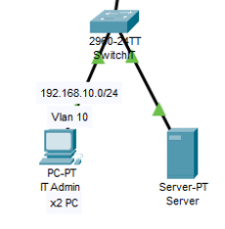
Network Diagram and topologies:-
This site consists of 2 IT administrators, and 1 server. The default gateway got IT Department is 192.168.10.1/24. IT Department is using VLAN 10 to control access between the groups.

Slide 14
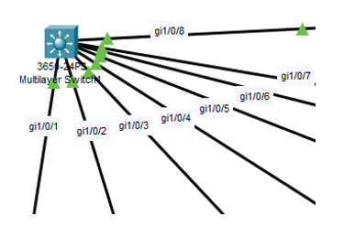
Trunk (encapsulation dot1q) is used at the Multilayer switch (layer 3 switch) as we want create VLAN traffic between the switches. A trunk connection is a normal link that is able to pass traffic from different VLANs and has a method to separate traffic between VLANs.
DHCP protocol are used on layer 3 switch so that it could enable automatic assignment of IP configurations for nodes on the network. It is efficient as we do not have to assign all the IP addresses manually. The DHCP server accepts address assignment requests and renewals from the client and assigns the addresses from predefined groups of addresses within DHCP address pools. These address pools are also be configured to supply additional information to the requesting client such as the IP address of the Domain Name System (DNS) server.

Slide 15
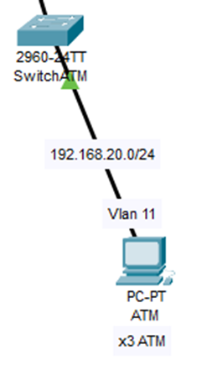
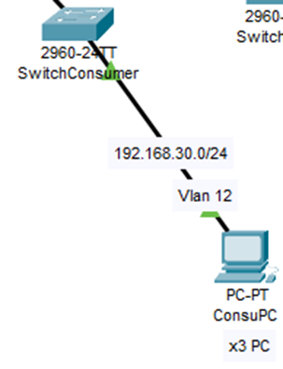
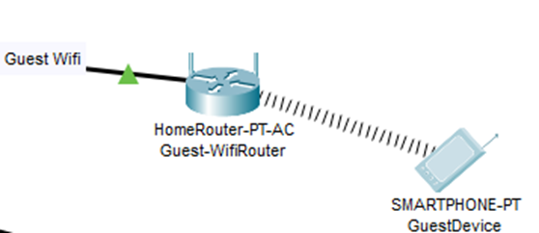
Sites in network
Guest Wifi site
Atm Site
Personal Banking site

Slide 16
Limitations:-
One of the limitation of this system is that it is not applicable in real world as it was simulated using packet tracer.
High initial cost.
Over reliance on networks.

Slide 17
References:-
A Short Guide to Network Disaster Recovery Planning. (2019, March 5). Retrieved from https://www.nakivo.com/blog/create-effective-network-disaster-recovery-plan/

Slide 18
THANK YOU

